Slide 1
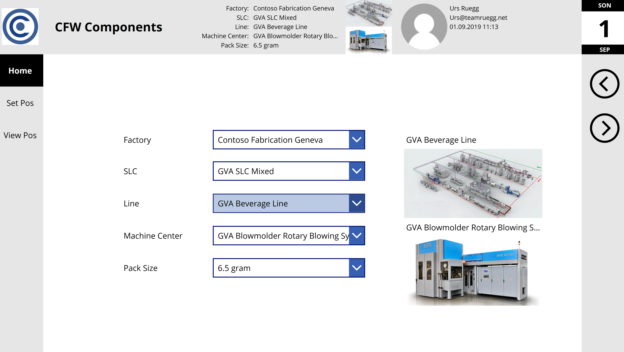
Header Control
Daily Tear Off Control
Nav Step Control
Sys Info Control

Slide 2
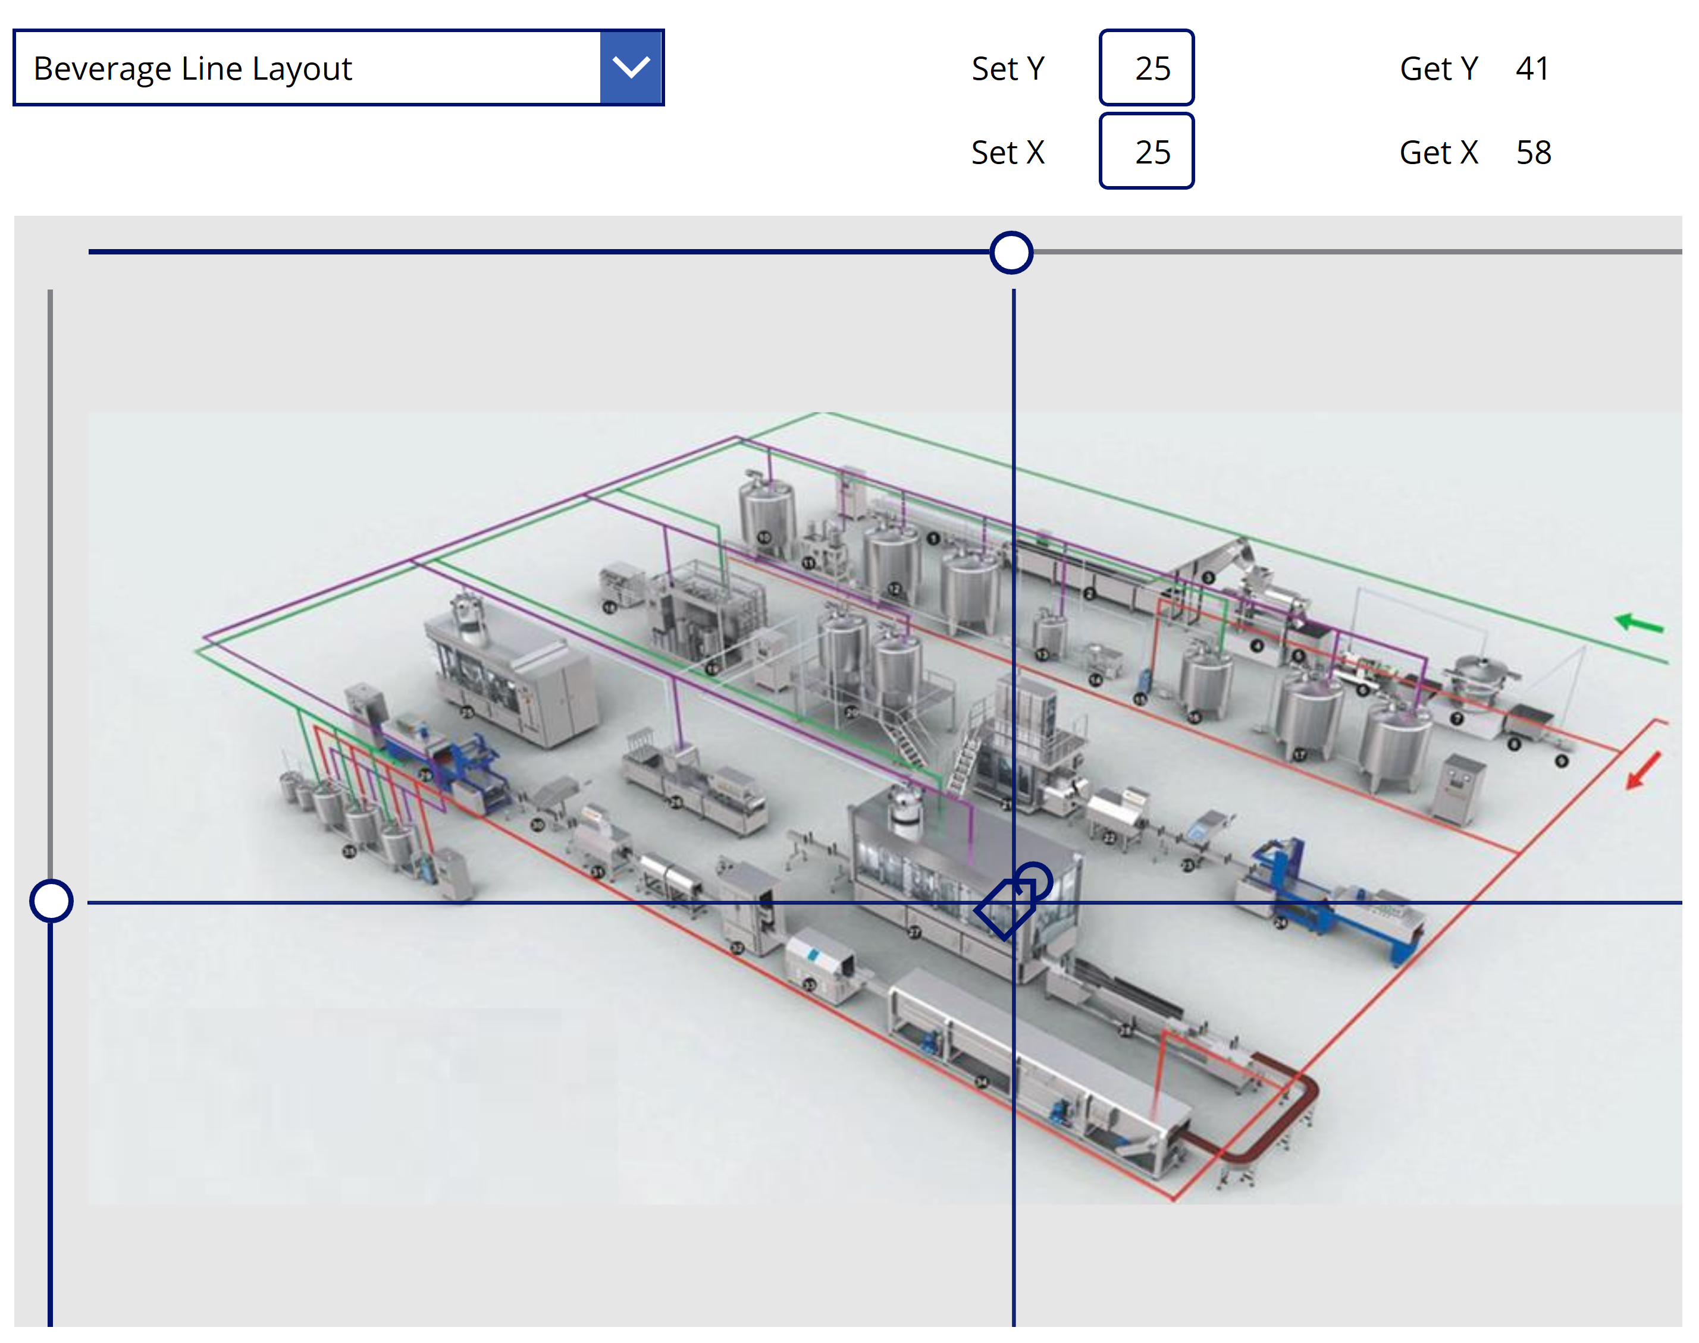
Map Position Set Control

Slide 3
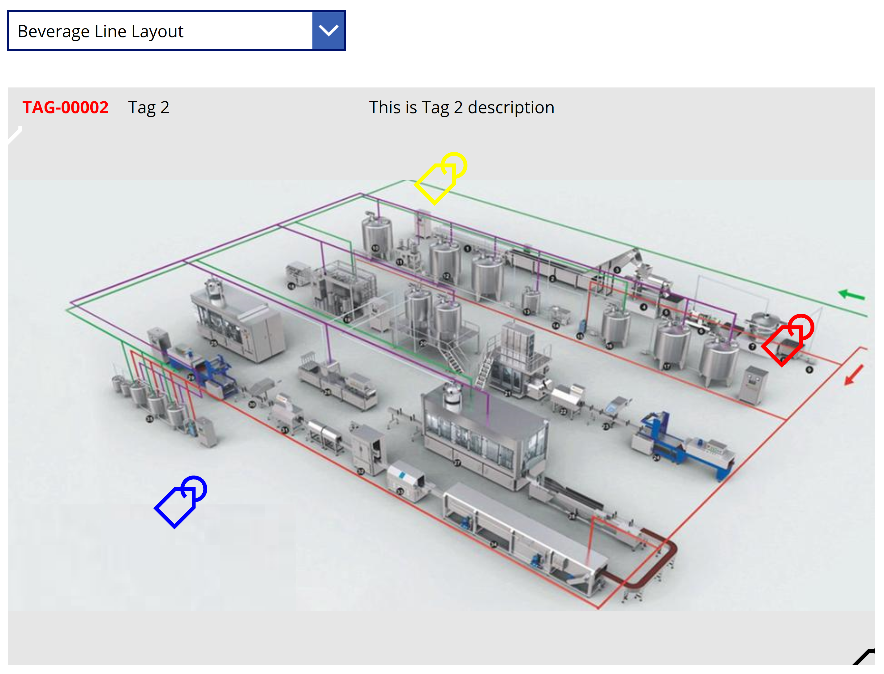
Map Position View Control

